Slide 1
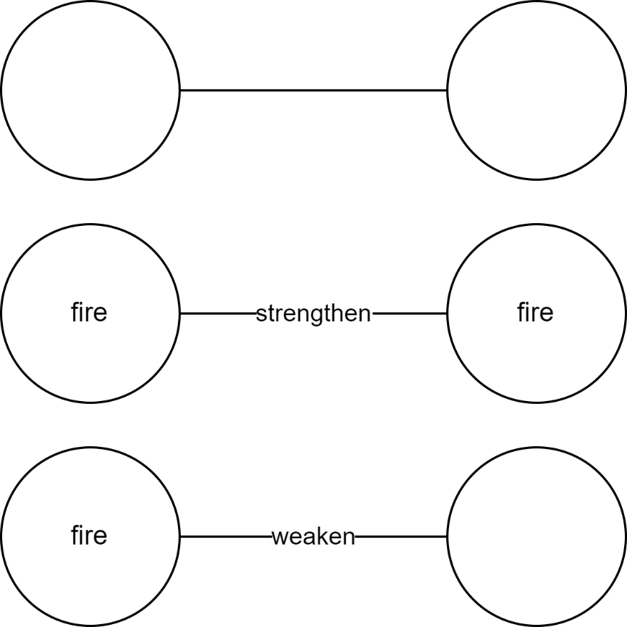
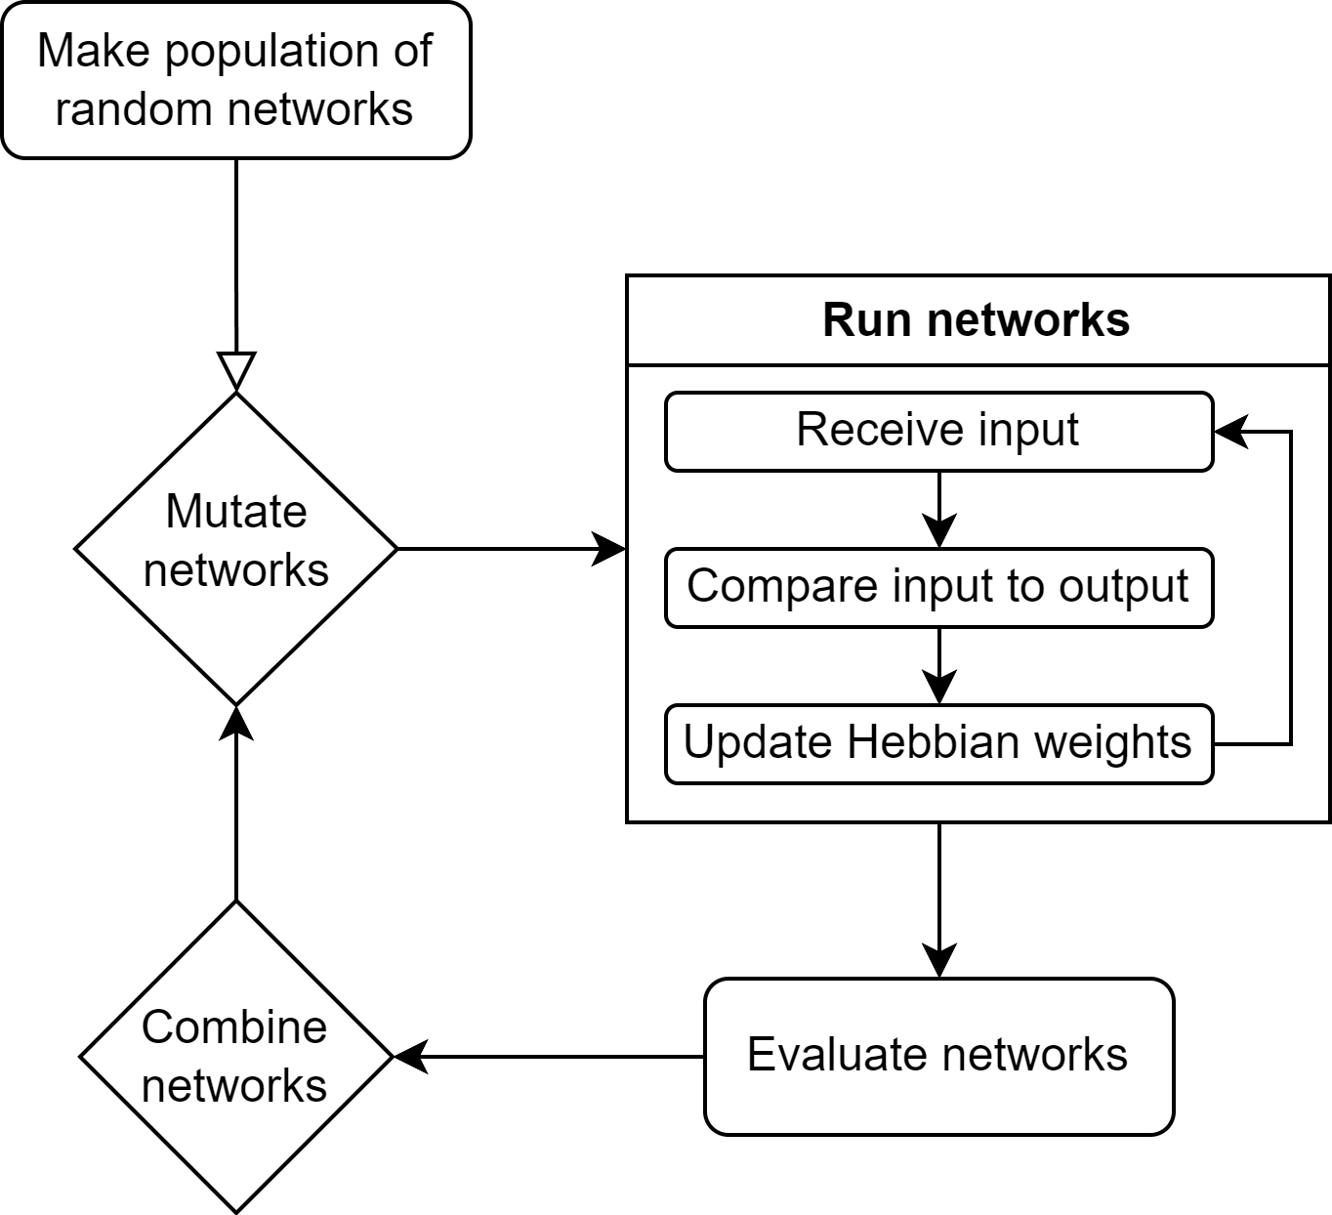
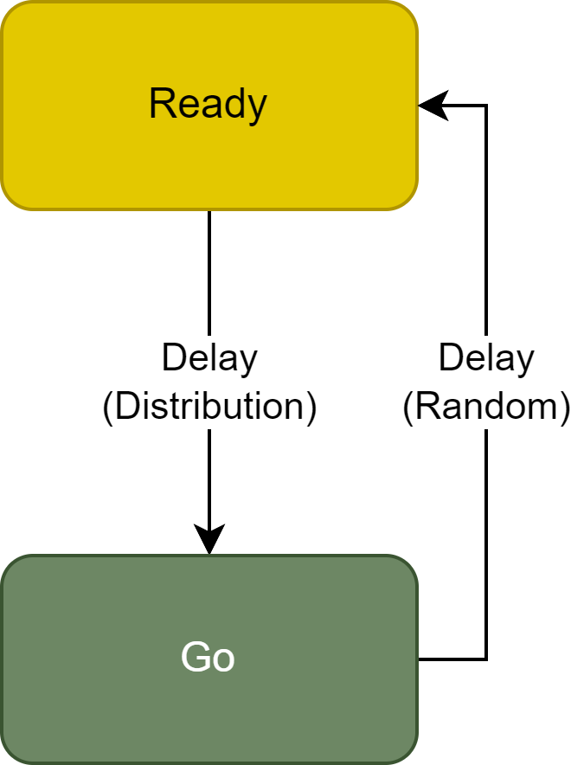
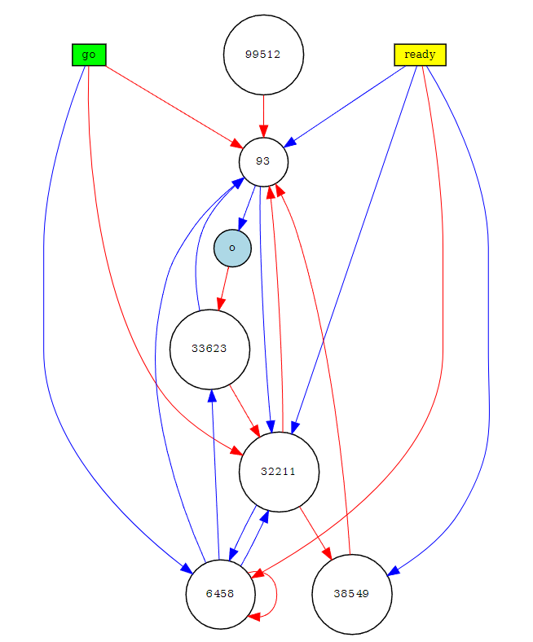
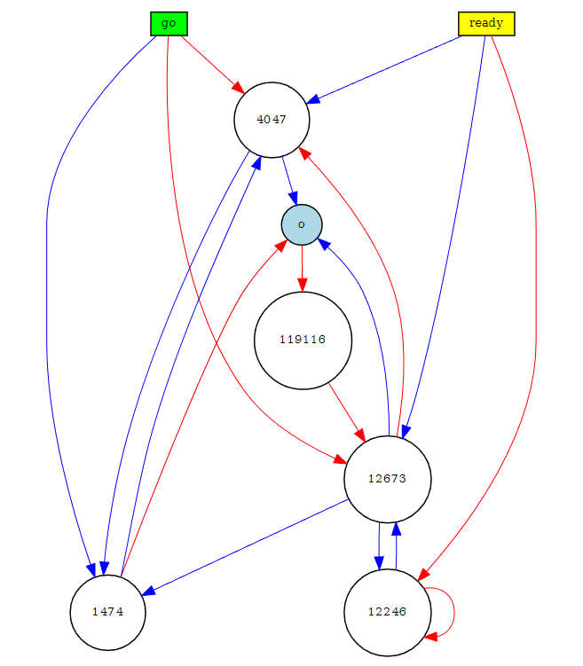
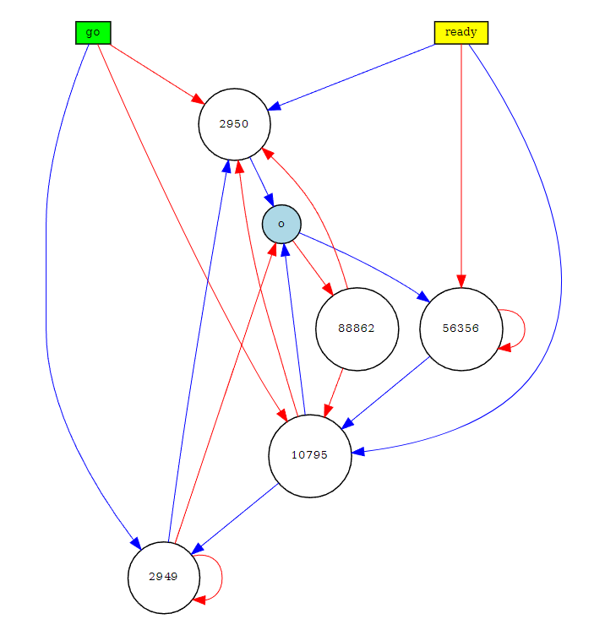
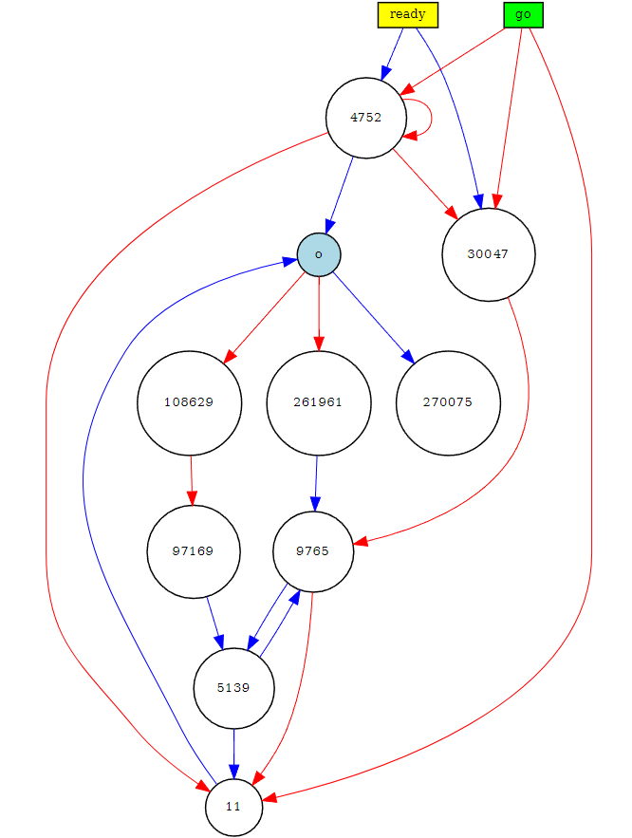
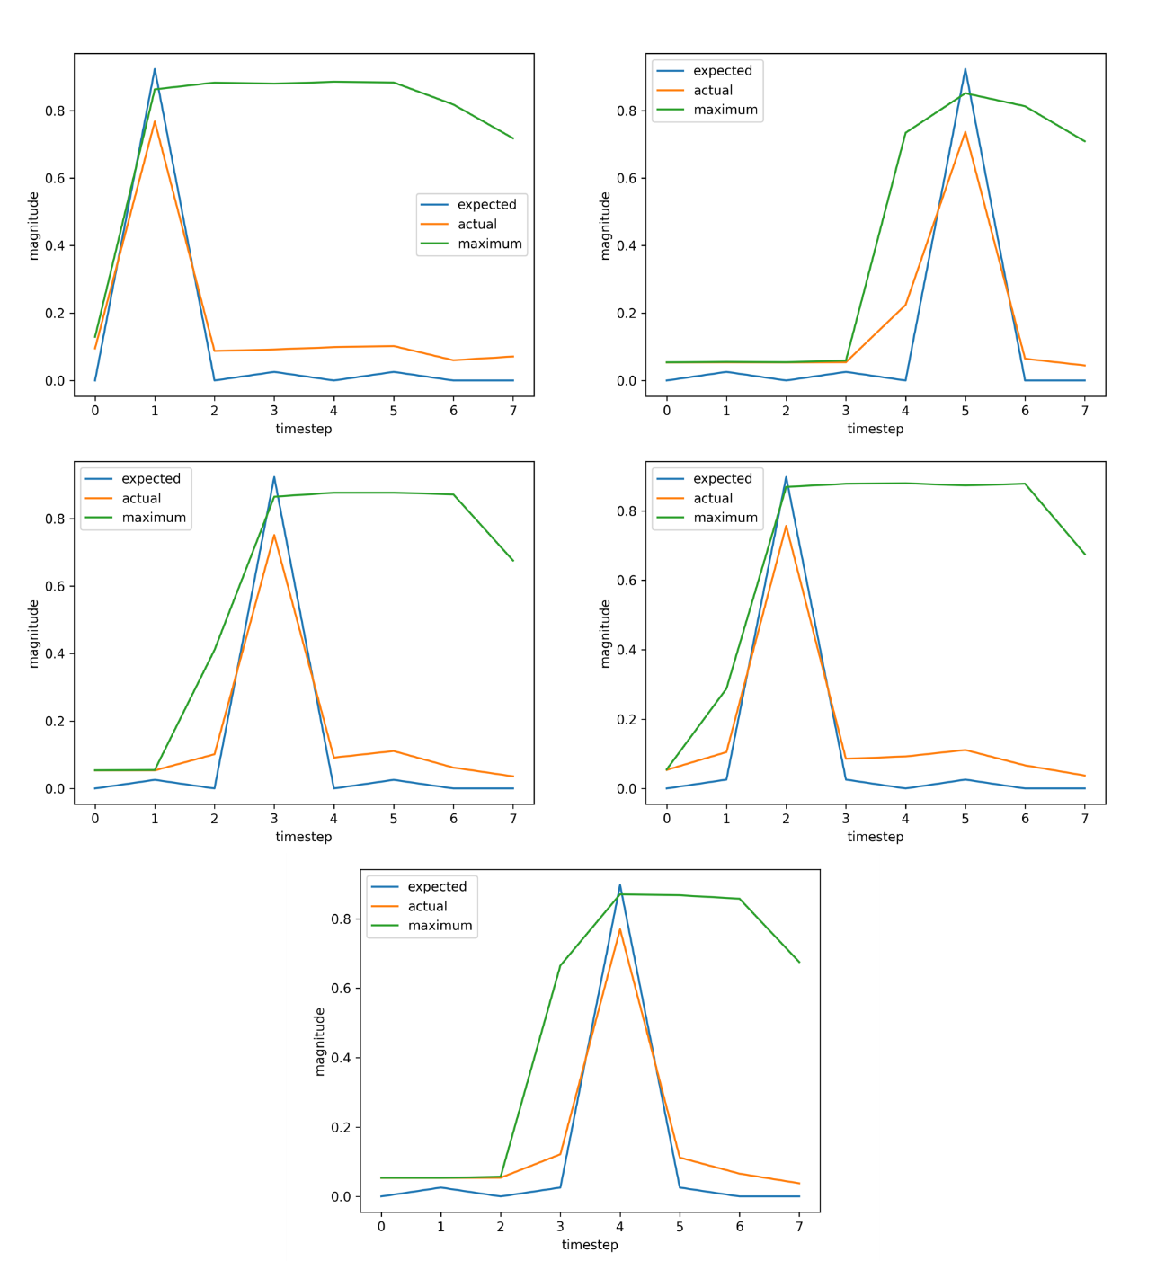
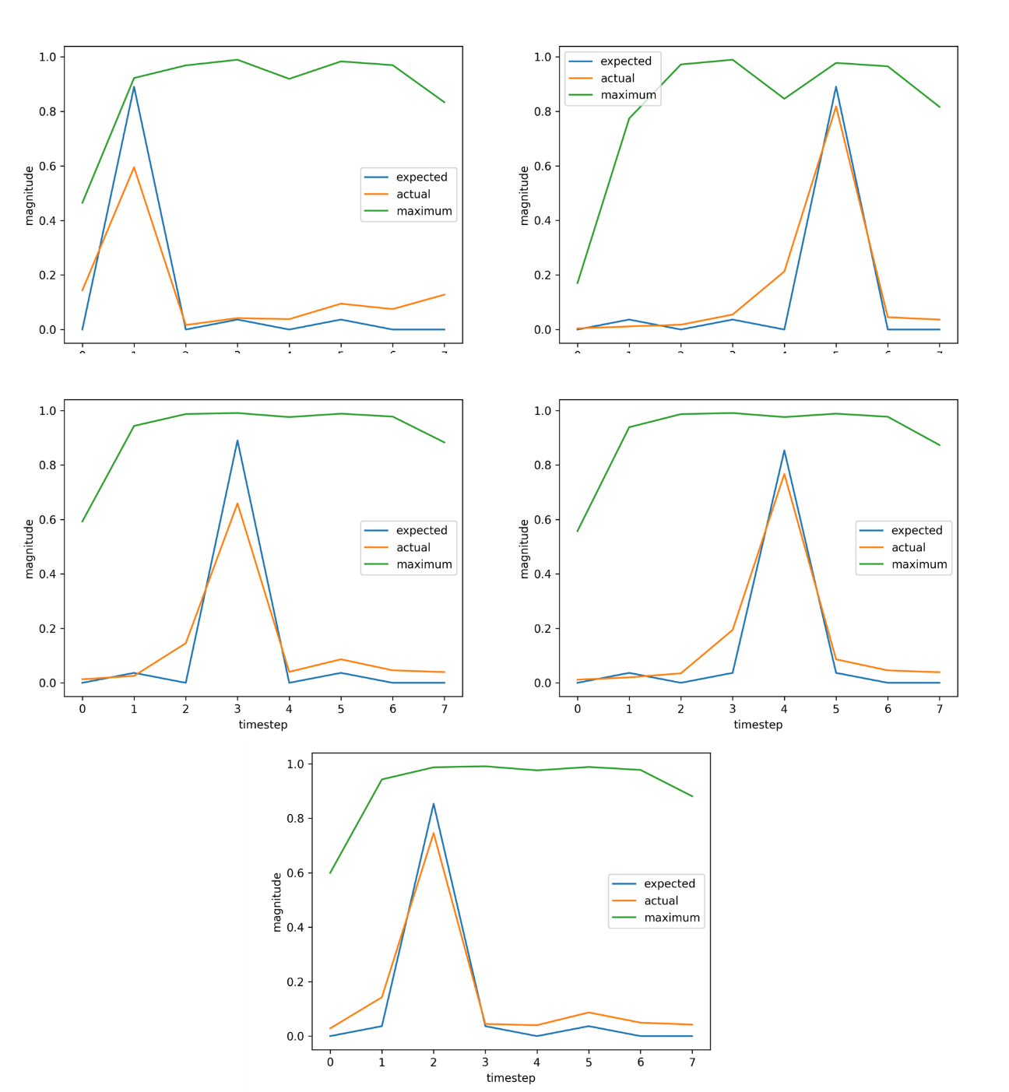
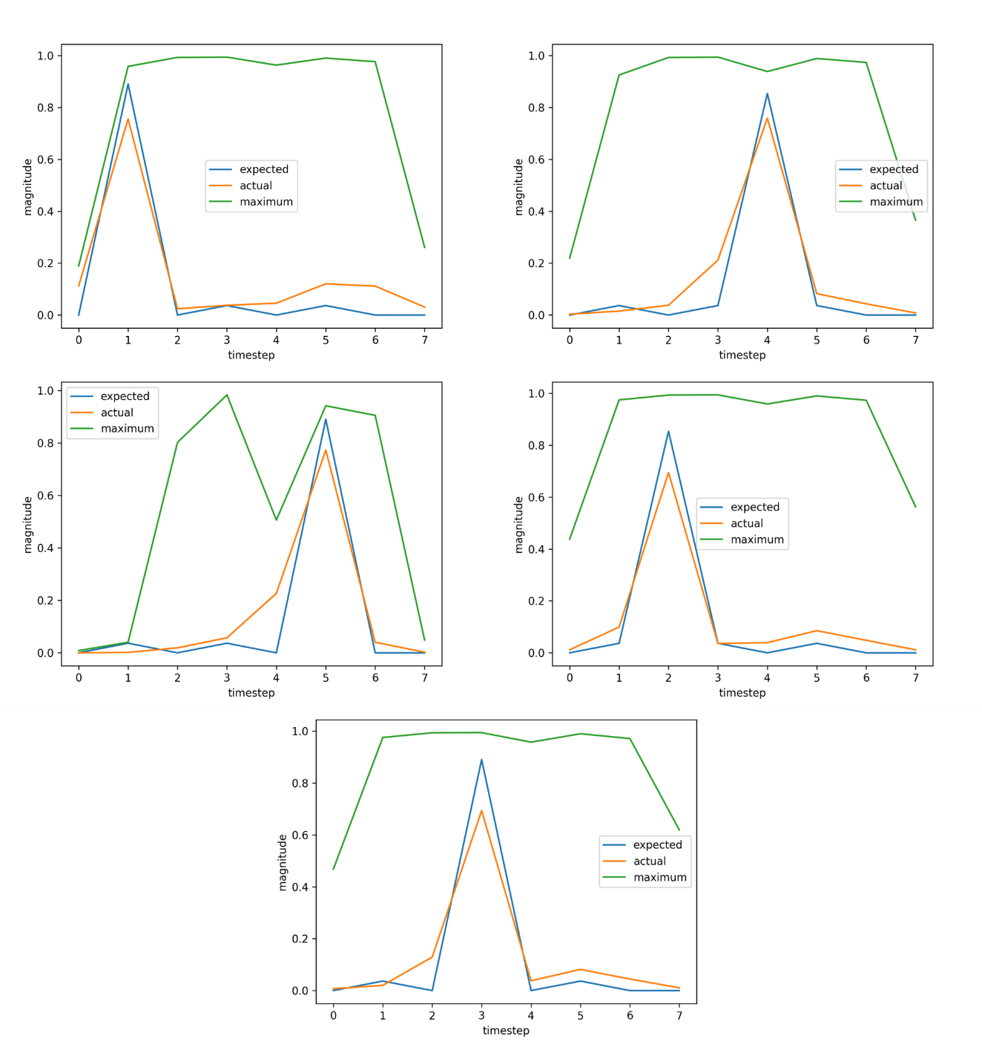
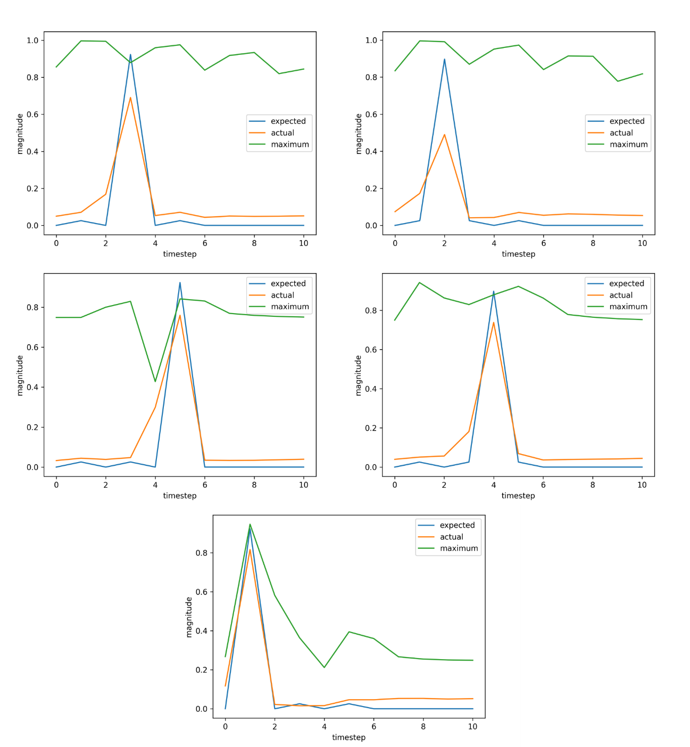
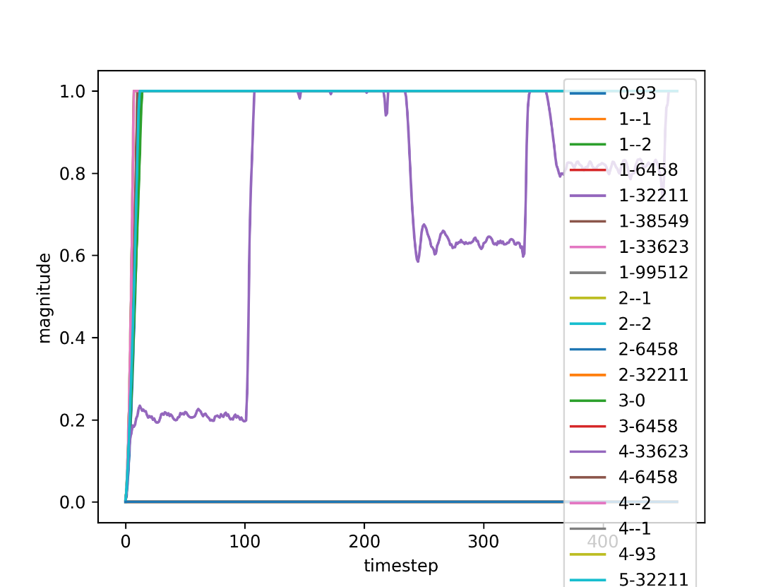
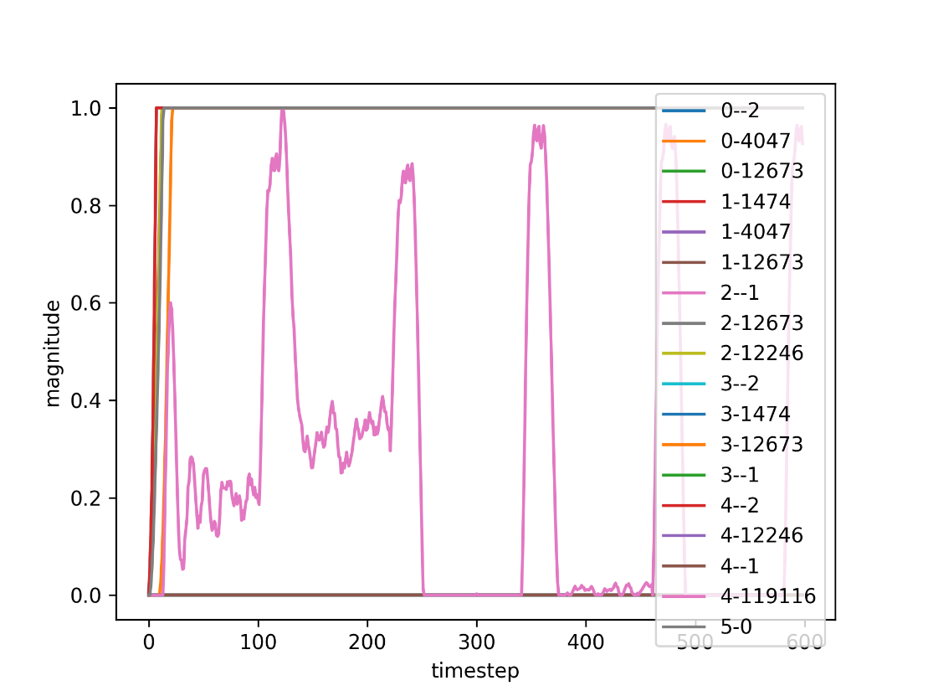
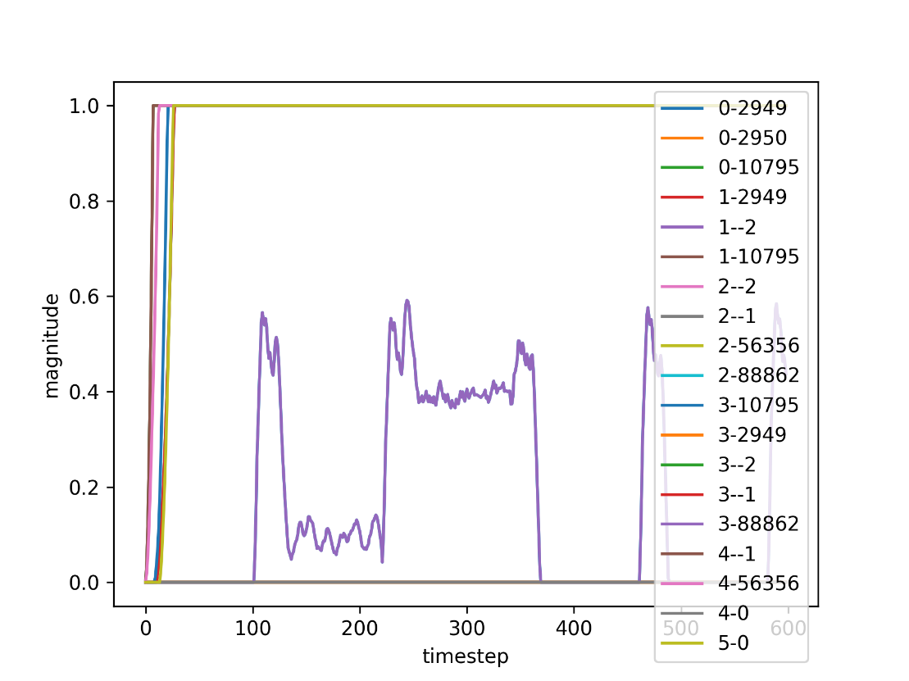
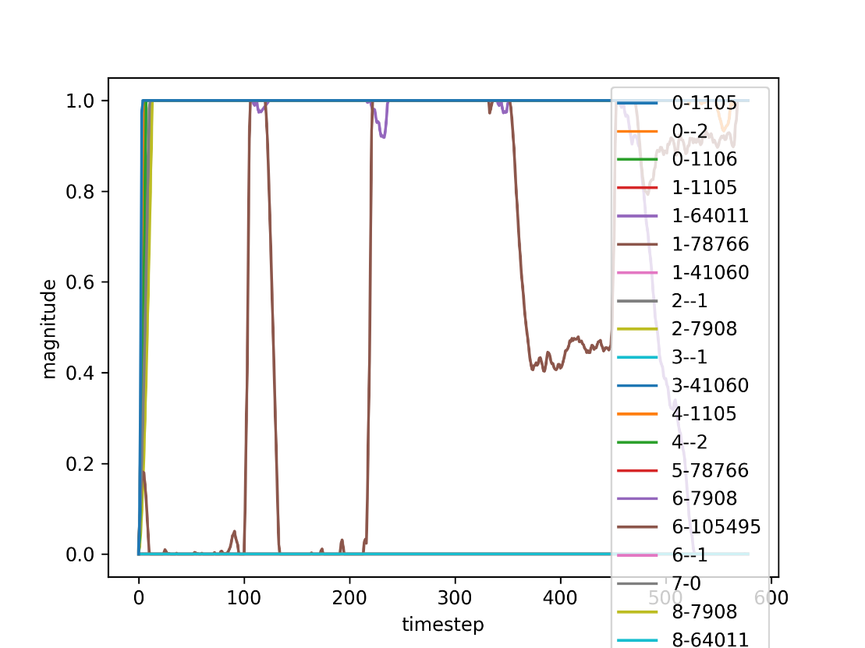
Evolving Biologically Plausible Networks for Temporal Prediction
Sondre H. Elgaaen, Felix B. Kern, Zenas C. Chao
Research Goals
Temporal Prediction
Biological Plausibility
This work combines the neuroevolutionary NEAT algorithm with Hebbian learning to evolve biologically plausible networks capable of temporal prediction and learning in an organic manner. Through this we hope to discover neural network structures that provide insight into how the brain performs temporal prediction.
Temporal prediction, where the brain anticipates future events from past data, can contribute to reaction times, rhythmic actions, and social interactions.
While we recognize key brain areas involved, the substructures facilitating these behaviors remain elusive.
Biological plausibility refers to AI models that mirror the brain's architecture and functions. By emulating natural neural systems, these networks provide insight into brain operations and improve AI adaptability and resilience.
Ready-Go Task
Hebbian Learning
NeuroEvolution of Augmenting Topologies (NEAT)
A simple timing-task aimed at developing networks whose only function is to encode the information needed to learn timings.
A Ready signal is sent to prepare the network for a coming Go signal, whose timing the network is made to predict. Then there’s a random delay before the next trial to ensure the network truly responds to the Ready signal.
Hebbian learning, often summarized as "neurons that fire together, wire together“, postulates that if two neurons on either side of a synapse are activated simultaneously, the strength of that synapse increases.
By utilizing Hebbian learning, evolved networks are able to learn in a biologically plausible manner.
NEAT generates artificial neural networks with topologies that evolve alongside network weights. By simulating evolution, NEAT can discover potent network architectures without extensive human design input.
By combining NEAT and Hebbian learning, we can explore wide arrays of network structures in an intelligent manner.
Results
Fitness: 0.9900384252534866
Fitness: 0.9860429304685272
Fitness: 0.9877155236019718
Fitness: 0.9810903398593736
Conclusion
Future Work
Acknowledgements
The evolved networks are well-performing, compact and biologically plausible. Combining NEAT and Hebbian learning shows promise for finding networks that can give insight into cognitive temporal functions. Systems to ensure interpretability of the results will be needed for more complex problems.
Generate networks with signed nodes directly and converting to a Spiking Neural Network.
Implement motifs for the interpretability of larger problem domains.
System to compare the found structures to substructures in the brain to improve empirical insights gained from the experiments.
For their academic, administrational and economic support, I thank the following:
Shoji Takeuchi, Kazuki Nishimoto and Morie Watanabe of the Takeuchi Lab
Yuri Marugata and Kaori Sato of the Office of International Relations
Kantaro Fujiwara of the IRCN
Pauline C. Haddow and Keith L. Downing of the Norwegian University of Science and Technology
Norwegian Ministry of Education and Research
Notes:
Add goal and conclusion
Conclusion?
“Structures can be learned”
“this or this is difficult”
“NEAT + Hebbian = good tool for finding biologically plausible topologies”
Rerun test for 12345-unordered-positive-dynamic-magnitude-hebbian-20-threshold-no-reset-2?

